Slide 1
Incremental Improvements to the Web User Experience
Sean Malley
Mentor: Candace Jackson

Slide 2
Transitioning Our CMS

Slide 3
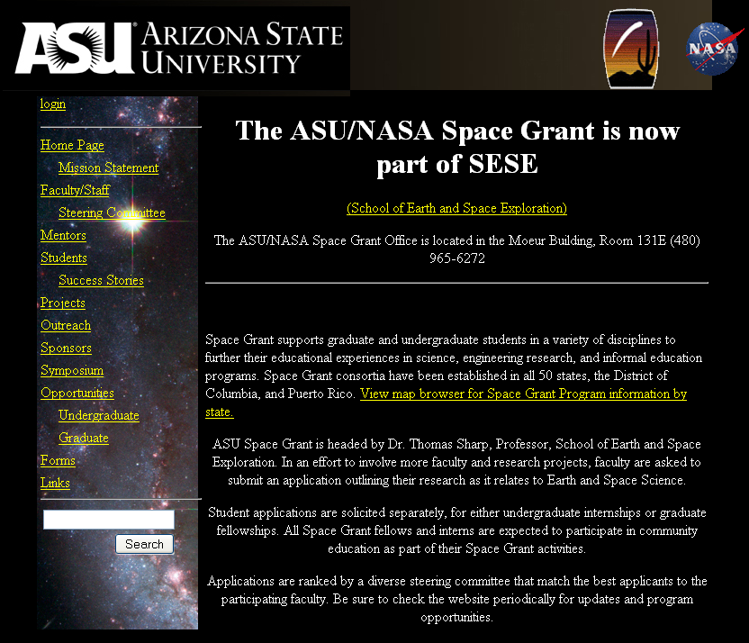
The Old Main Page
Not Easily Themable
Complex Content Management
Poor Structure
No User Interactivity

Slide 4
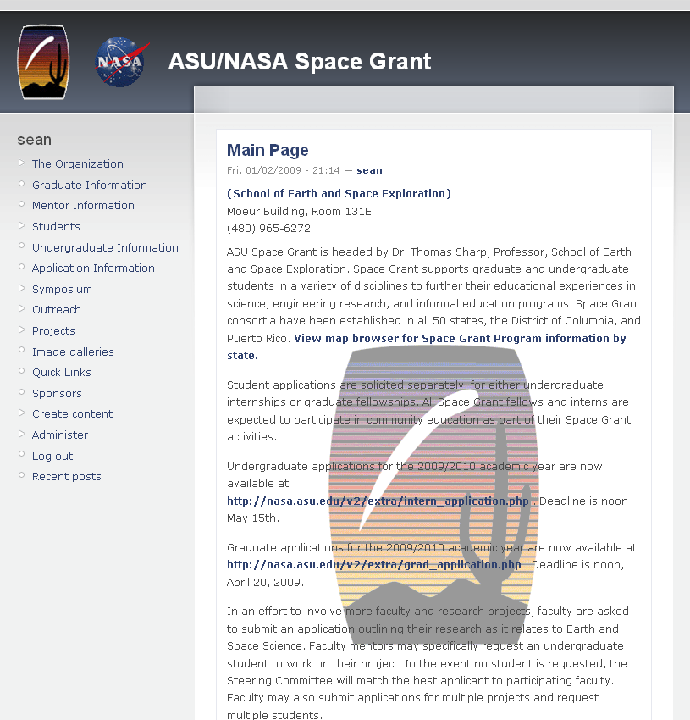
The New NASA
Simple Theming
Centralized Content Management
User commenting, Statistics, Tracking

Slide 5
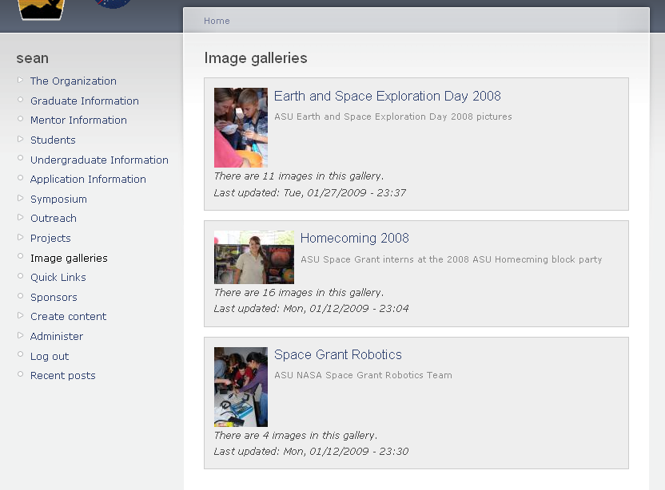
The New Gallery

Slide 6
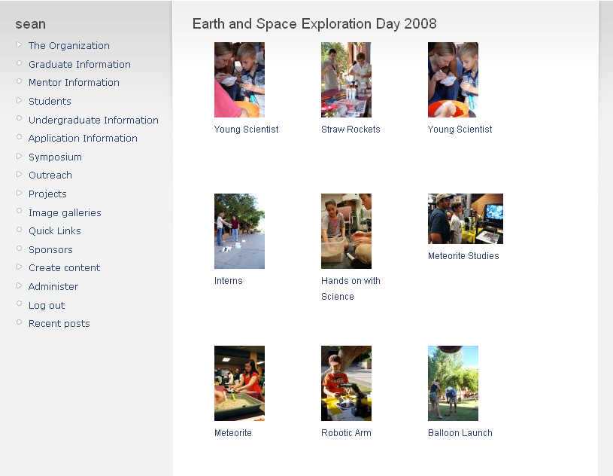
The New Gallery

Slide 7
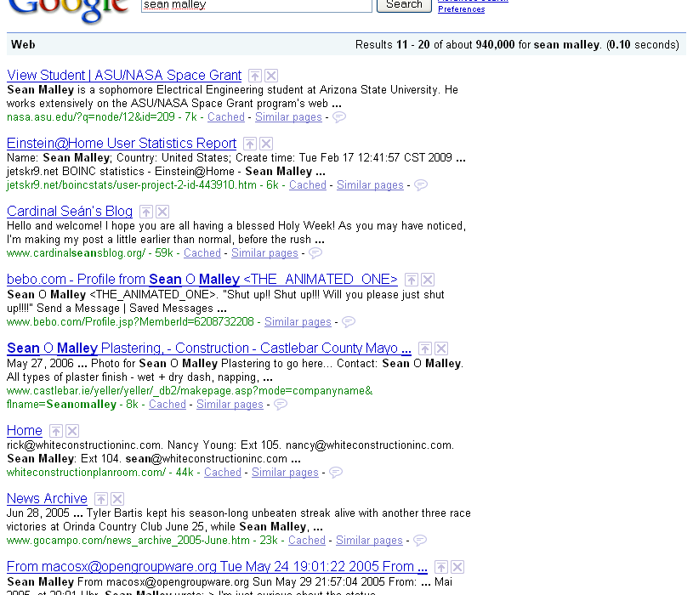
New Structure
Cleaner More Easily Maintainable Code
All Pages Across Site Updated
Better Rendering & Screen Reader Access
Better Search Engine Ranks

Slide 8
Continuing Site Analysis to Improve the User Experience

Slide 9
Basic Traffic Statistics
~170 unique visitors per day
40% of Traffic occurs on Sunday and Monday
Average visit approximately 220 seconds
Most Requested Pages:
  Intern Application
  Graduate Application
  Opportunities Page

Slide 10
User Applciations/Submissions

Slide 11
Search Engines

Slide 12
Top 10 Referrers (2 months)
Referrer | Hits | Percentage
http://nasa.asu.edu | 1423 | 79.23%
http://www.google.com | 110 | 6.12%
http://spacegrant.arizona.edu | 65 | 3.62%
http://www.asuwebdevil.com | 63 | 3.51%
http://www.ams.org | 33 | 1.84%
http://search.asu.edu | 23 | 1.28%
http://images.google.com | 15 | 0.84%
http://search.live.com | 7 | 0.39%
http://mail.google.com | 6 | 0.33%
http://us.mg1.mail.yahoo.com | 6 | 0.33%

Slide 13
Implementing Modifications
Adding top level links for pages resulting in long user search times
Monitor search engine keywords to expand content
Optimize for most common browsers
New procedures for load balancing and form testing
Automate as many staff intensive tasks as possible

Slide 15
Most Common Searches
Phrase |  | Percent
asu nasa space grant |  | 15.85%
nasa space grant asu |  | 9.76%
asu space grant |  | 6.10%
***REDACTED** |  | 4.88%
***REDACTED** |  | 3.66%
***REDACTED** |  | 3.66%
straw rockets |  | 3.66%
nasa straw rockets |  | 2.44%
nasa space |  | 2.44%
***REDACTED** |  | 2.44%

